Slide 1
INTRODUCTORY MATHEMATICAL ANALYSIS for Business, Economics, and the Life and Social Sciences
Arab World Edition
Chapter 2
Functions, Graphs, and Lines
© Pearson Education Limited 2012

Slide 2
  Chapter 2: Functions, Graphs, and Lines
2.1 Functions
A function a rule that assigns each input number to one output number.
Form from Y → X
“ to each element in X a unique value in Y”
The set of all input numbers is the domain of the function.
The set of all output numbers is the range.

Slide 3
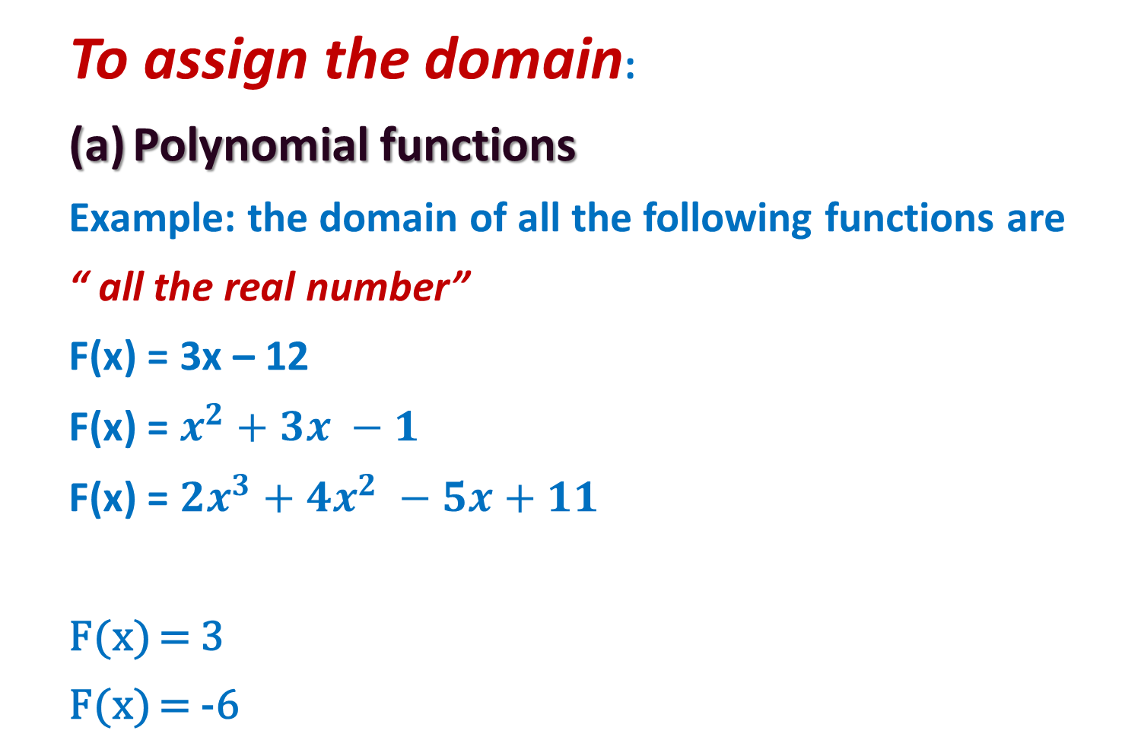
  To assign the domain:
  Polynomial functions
  Example: the domain of all the following functions are
  “ all the real number”
  F(x) = 3x – 12
  F(x) = $x^{2}+3x −1$
  F(x) = ${2x}^{3}+4x^{2} −5x+11$
  F(x) = 3
  F(x) = -6

Slide 4
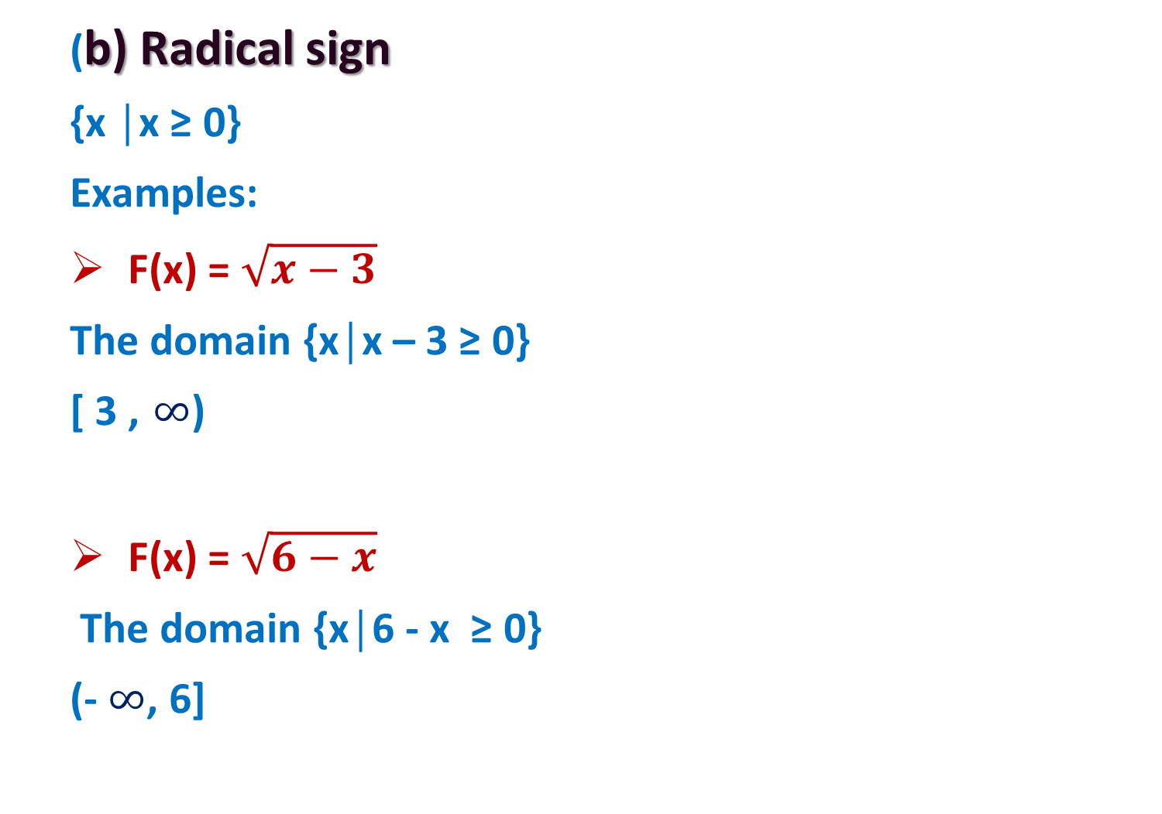
  (b) Radical sign
  {x │x ≥ 0}
  Examples:
  F(x) = $\sqrt{x−3}$
  The domain {x│x – 3 ≥ 0}
  [ 3 , $∞$)
  F(x) = $\sqrt{6−x}$
  The domain {x│6 - x ≥ 0}
  (- $∞$, 6]

Slide 5
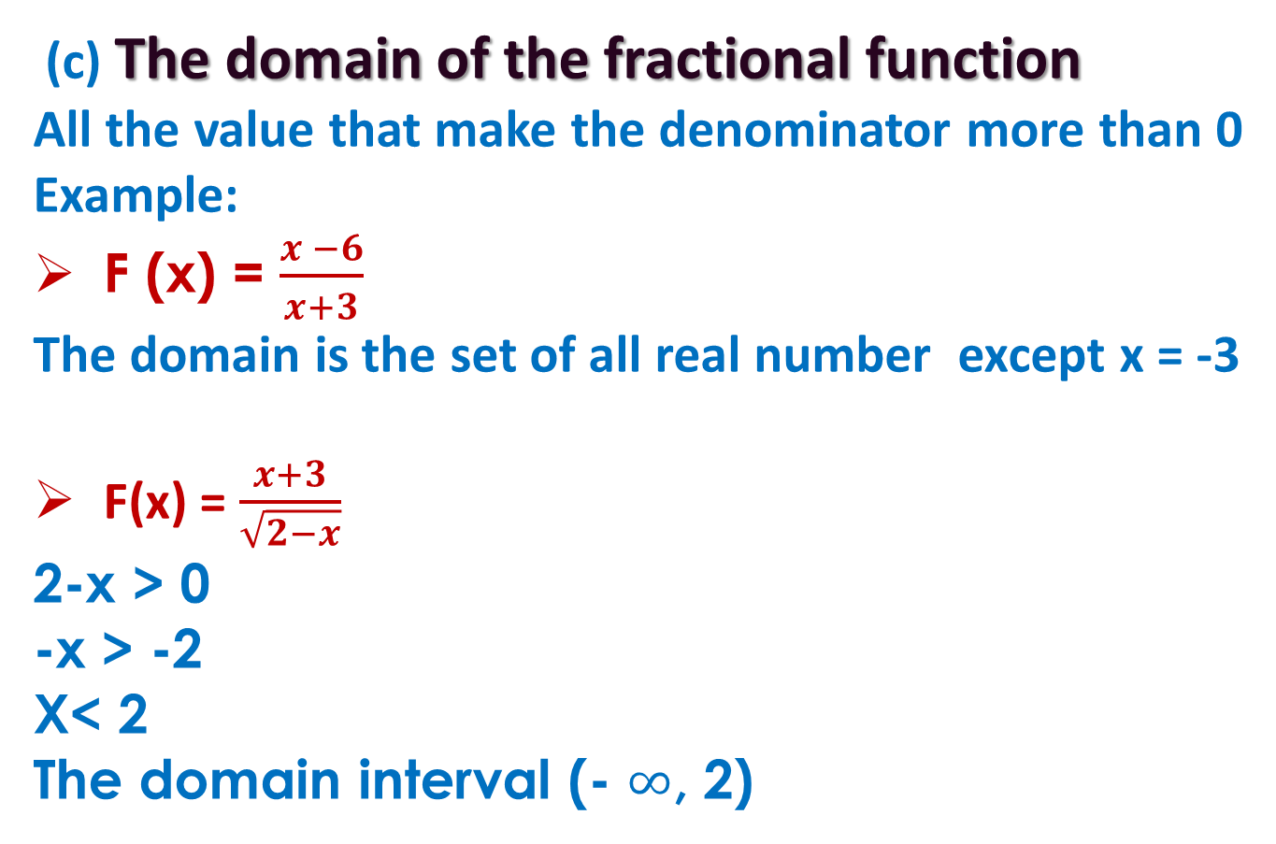
(c) The domain of the fractional function
All the value that make the denominator more than 0
Example:
F (x) = $\frac{x −6}{x+3}$
The domain is the set of all real number except x = -3
F(x) = $\frac{x+3}{\sqrt{2−x}}$
2-x > 0
-x > -2
X< 2
The domain interval (- $∞$, 2)

Slide 6
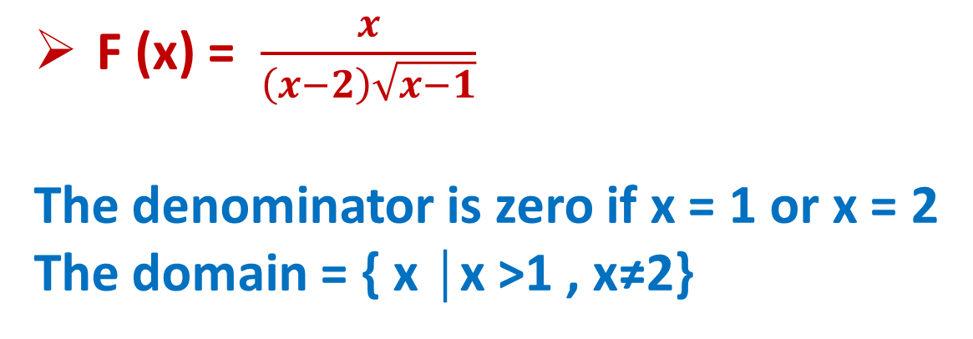
F (x) = $\frac{x}{\left(x−2\right)\sqrt{x−1}}$
The denominator is zero if x = 1 or x = 2
The domain = { x │x >1 , x≠2}

Slide 7
  Chapter 2: Functions, Graphs, and Lines
  2.1 Functions
  Example 3 – Finding Domain and Function Values
Let g(x) = 3x² – x + 5.
Any real number can be used for x, so the domain of g is all real numbers.
Find g(z)
Solution:
Find g(r²) Solution:
Find g(x + h) Solution:

Slide 8
  Chapter 2: Functions, Graphs, and Lines
  2.2 Special Functions
Constant function
A function of the form h(x) = c, where c = constant, is a constant function.
Example 4 – Constant Function
Let h(x) = 2, the domain of h is all real numbers.
h(10) = 2 h(–387) = 2 h(x + 3) = 2

Slide 9
  Chapter 2: Functions, Graphs, and Lines
  2.2 Special Functions
Rational Function
A rational function is a function in which the numerator and denominator are both polynomials
is a rational function, since the numerator and denominator are both polynomials.
Note that f(x) is not defined when x = –5

Slide 10
  Piecewise-defined function: a function which is specified by rules for each of several disjoint cases.
  Example 13 : let
  Find:
  F(0) , F(2) and F(7)
  Solution:
  F(0) = 1
  F(2) = 0
  F(7) = 4

Slide 11
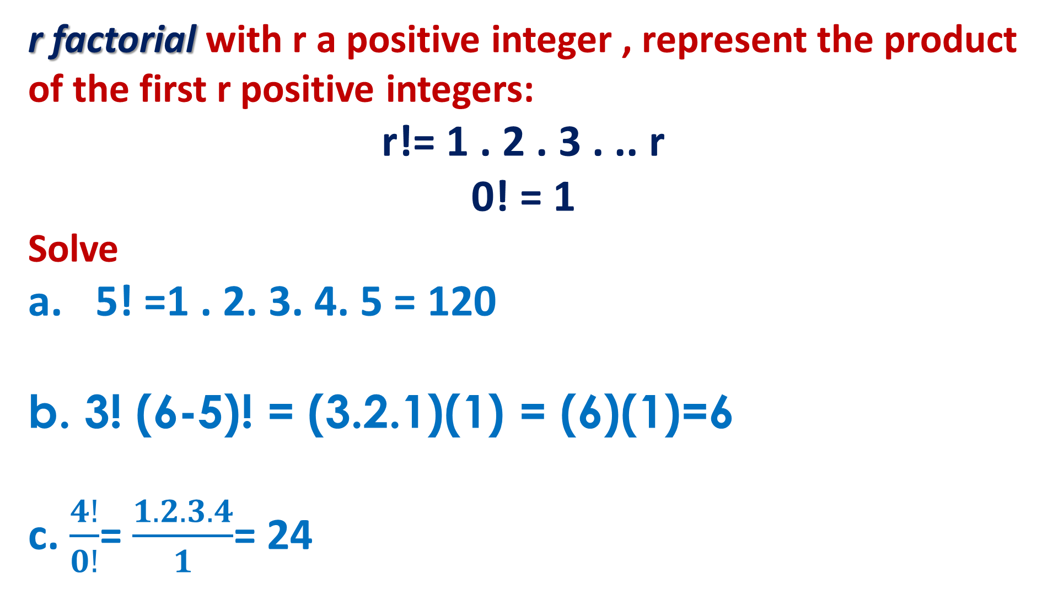
r factorial with r a positive integer , represent the product of the first r positive integers:
r!= 1 . 2 . 3 . .. r
0! = 1
Solve
5! =1 . 2. 3. 4. 5 = 120
b. 3! (6-5)! = (3.2.1)(1) = (6)(1)=6
c. $\frac{4!}{0!}$= $\frac{1.2.3.4}{1}$= 24

Slide 12
  Chapter 2: Functions, Graphs, and Lines
2.3 Combinations of Functions
We define the operations of function as:
  Example 18 – Combining Functions
If f(x) = 3x – 1 and g(x) = x² + 3x, find
  Solution:
  Solution:

Slide 13
  Chapter 2: Functions, Graphs, and Lines
  2.3 Combinations of Functions
  Example 18 – Combining Functions
  Solution:
  Solution:
  Solution:

Slide 14
  Chapter 2: Functions, Graphs, and Lines
  2.3 Combinations of Functions
  Example 18 – Combining Functions
Composition
Composite of f with g is defined by

Slide 15
  Chapter 2: Functions, Graphs, and Lines
  2.3 Combinations of Functions
  Example 20 – Composition
  If F(p) = p² + 4p – 3, G(p) = 2p + 1, find
  F(G(p))
  Solution:
  b. G(F(1))
  Solution:

Slide 16
Rectangular coordinates or x ,y – plane
The rectangular coordinate system provides a geometric way to graph equations in two variables.
Origin (0,0)
Ordered pair (x,y)
Quadrants
X-intercept: a point where a curve or line intersects with x- axis ,
found by setting y=0 and solving for x
Y-intercept: a point where a curve or line intersects with y- axis ,
found by setting x=0 and solving for y

Slide 17
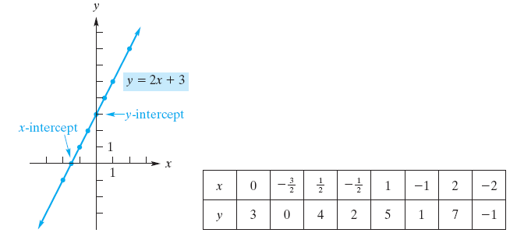
  Example 27 – Intercepts and Graph
If y = 2x + 3 Find;
x- intercept
y-intercept
sketch the graph.
  The domain
  The range
  Solution:
  When y = 0, we have 0 = 2x + 3 so that
When x = 0, y = 2(0) + 3 = 3
( , 3)
  The domain: all the real number
  The range : all the real number

Slide 18
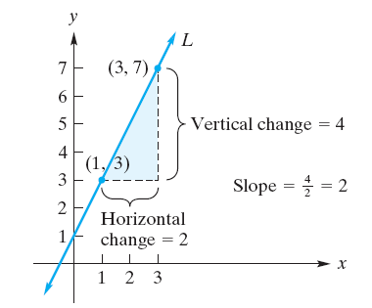
Slope of a Line
The slope of the line is for two different points (x₁, y₁) and (x₂, y₂) is
2.6 Lines
Relationships represented by lines
Zero slope: horizontal line m = 0
Undefined slope: vertical line
Positive slope: line rises from right to left m > 0
Negative slope: line falls from left to right m < 0

Slide 19
point-slope form
A point-slope form of an equation of the line through (x₁, y₁) with slope m is
Slope intercept form:
Y = mx +b
General linear form
Ax+By+C=0
Vertical line
X=a
Horizontal line
y=b

Slide 20
  Example 37 – Determining a Line from Two Points
Find an equation of the line passing through (–3, 8) and (4, –2).
Solution:
The line has slope
Using a point-slope form with (–3, 8) gives

Slide 21
  Chapter 2: Functions, Graphs, and Lines
  2.6 Lines
  Example 41 – Converting Forms of Equations of Lines
Find a general linear form of the line whose slope-intercept form is
Solution:
By clearing the fractions, we have

Slide 22
  Chapter 2: Functions, Graphs, and Lines
  2.6 Lines
  Example 41 – Converting Forms of Equations of Lines
b. Find the slope-intercept form of the line having a general linear form
Solution:
We solve the given equation for y,

Slide 23
  Example 39 – Find the Slope and y-intercept of a Line
Find the slope and y-intercept of the line with equation y = 5(3 – 2x).
Solution:
Rewrite the equation as
The slope is –10 and the y-intercept is 15.

Slide 24
Parallel and Perpendicular Lines
Parallel Lines are two lines that have the same slope.
Perpendicular Lines are two lines with slopes m₁ and m₂ perpendicular to each other only if

Slide 25
Determine weather the lines are parallel , perpendicular , or neither
Y=-5x + 7 , y = -5x – 3
Y = 5x + 2 , -5x +y -3 = 0
Y= 4x – 8 , y = 12 – 4x
X + 3y +5=0 , y = -3x

